Slide 1
DTS207TC Database Development and Design
Lecture 2
Mid-level SQL
Page titles with * will not be assessed
Di Zhang, Autumn 2025
Notes:
I am very happy to have the opportunity to meet with you all in this course.

Slide 2
*SQL Interview Questions Website
China Big Company
  https://www.nowcoder.com/ta/sql
  https://www.mianshiya.com/tag/SQL
International Company
  https://leetcode.cn/problemset/database/
  https://www.stratascratch.com
-- You will be asked to be tested without AI and Internet in real interview…

Slide 3
*Tips on CW
Correctness
Efficiency
Completeness
Document quality

Slide 4
Joined Relations
Join operations take two relations and return as a result another relation.
A join operation is a Cartesian product which requires that tuples in the two relations match (under some condition). It also specifies the attributes that are present in the result of the join
The join operations are typically used as subquery expressions in the from clause
Three types of joins:
  Natural join
  Inner join
  Outer join

Slide 5
Natural Join in SQL
Natural join matches tuples with the same values for all common attributes, and retains only one copy of each common column.
List the names of instructors along with the course ID of the courses that they taught
  select name, course_id
  from students, takes
  where student.ID = takes.ID;
Same query in SQL with “natural join” construct
  select name, course_id
  from student natural join takes;

Slide 6
Natural Join in SQL (Cont.)
The from clause can have multiple relations combined using natural join:
  select A₁, A₂, … A_{n}
  from r₁ natural join r₂ natural join .. natural join r_{n}
  where P ;

Slide 7
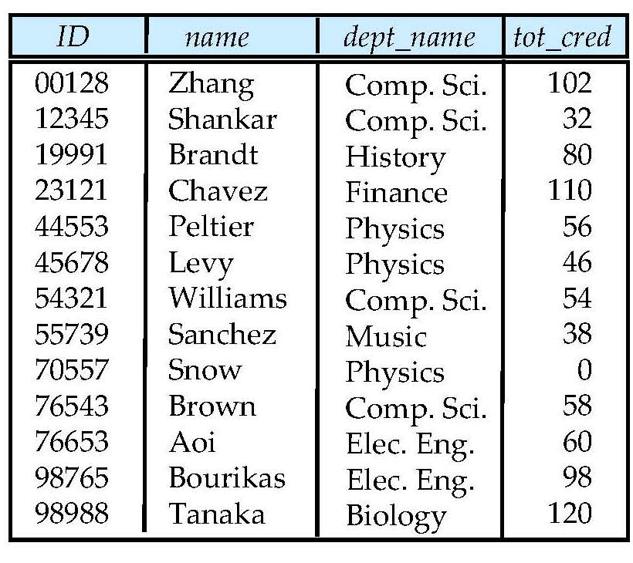
Example: Student Relation

Slide 8
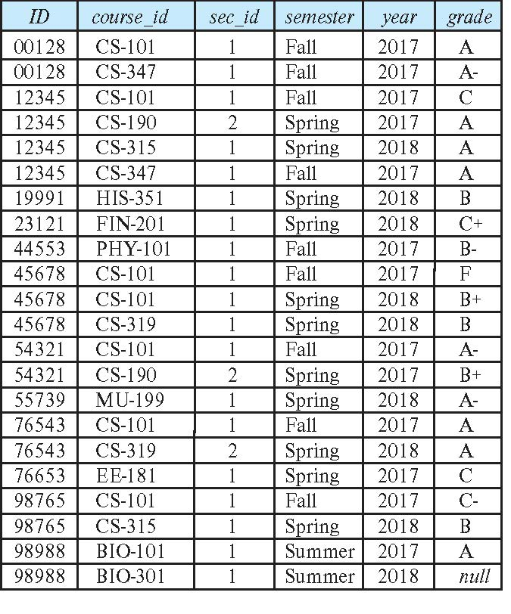
Takes Relation

Slide 9

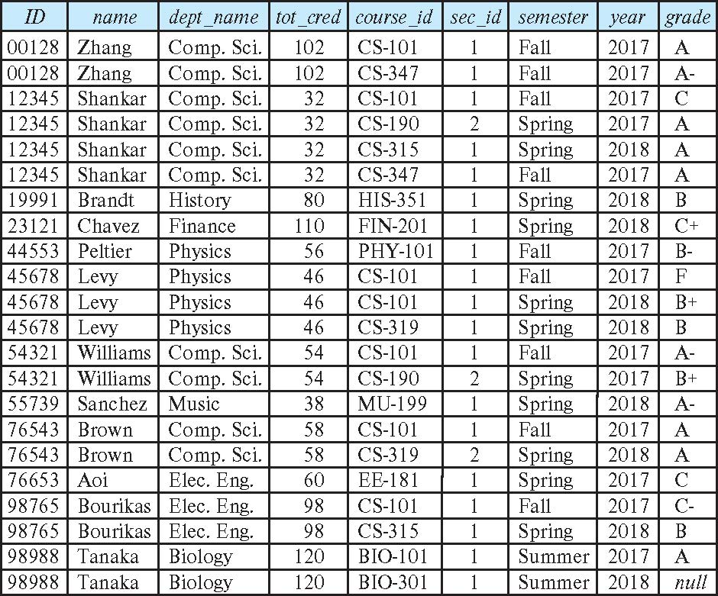
student natural join takes

Slide 10
Dangerous in Natural Join
Beware of unrelated attributes with same name which get equated incorrectly
Example -- List the names of students instructors along with the titles of courses that they have taken
  Correct version
  select name, title
  from student natural join takes, course
  where takes.course_id = course.course_id;
  Incorrect version
    select name, title
    from student natural join takes natural join course;
    This query omits all (student name, course title) pairs where the student takes a course in a department other than the student's own department.
    The correct version (above), correctly outputs such pairs.
Notes:
-- 1. build table
CREATE TABLE student (
id text PRIMARY KEY,
name text NOT NULL,
dept_name text NOT NULL,
tot_cred integer CHECK (tot_cred >= 0)
);
INSERT INTO student (id, name, dept_name, tot_cred) VALUES
('00128', 'Zhang', 'Comp. Sci.', 102),
('12345', 'Shankar', 'Comp. Sci.', 32),
('19991', 'Brandt', 'History', 80),
('23121', 'Chavez', 'Finance', 110),
('44553', 'Peltier', 'Physics', 56),
('45678', 'Levy', 'Physics', 46),
('54321', 'Williams', 'Comp. Sci.', 54),
('55739', 'Sanchez', 'Music', 38),
('70557', 'Snow', 'Physics', 0),
('76543', 'Brown', 'Comp. Sci.', 58),
('76653', 'Aoi', 'Elec. Eng.', 60),
('98765', 'Bourikas', 'Elec. Eng.', 98),
('98988', 'Tanaka', 'Biology', 120);
--select * from student;
-- 2. build table
CREATE TABLE takes (
id CHAR(5),
course_id VARCHAR(8),
sec_id VARCHAR(4),
semester VARCHAR(6),
year INTEGER,
grade VARCHAR(2),
PRIMARY KEY (id, course_id, sec_id, semester, year),
FOREIGN KEY (id) REFERENCES student(id)
ON DELETE CASCADE
);
INSERT INTO takes (id, course_id, sec_id, semester, year, grade) VALUES
('00128', 'CS-101', '1', 'Fall', 2017, 'A'),
('00128', 'CS-347', '1', 'Fall', 2017, 'A-'),
('12345', 'CS-101', '1', 'Fall', 2017, 'C'),
('12345', 'CS-190', '2', 'Spring', 2017, 'A'),
('12345', 'CS-315', '1', 'Spring', 2018, 'A'),
('12345', 'CS-347', '1', 'Fall', 2017, 'A'),
('19991', 'HIS-351', '1', 'Spring', 2018, 'B'),
('23121', 'FIN-201', '1', 'Spring', 2018, 'C+'),
('44553', 'PHY-101', '1', 'Fall', 2017, 'B-'),
('45678', 'CS-101', '1', 'Fall', 2017, 'F'),
('45678', 'CS-101', '1', 'Spring', 2018, 'B+'),
('45678', 'CS-319', '1', 'Spring', 2018, 'B'),
('54321', 'CS-101', '1', 'Fall', 2017, 'A-'),
('54321', 'CS-190', '2', 'Spring', 2017, 'B+'),
('55739', 'MU-199', '1', 'Spring', 2018, 'A-'),
('76543', 'CS-101', '1', 'Fall', 2017, 'A'),
('76543', 'CS-319', '2', 'Spring', 2018, 'A'),
('76653', 'EE-181', '1', 'Spring', 2017, 'C'),
('98765', 'CS-101', '1', 'Fall', 2017, 'C-'),
('98765', 'CS-315', '1', 'Spring', 2018, 'B'),
('98988', 'BIO-101', '1', 'Summer', 2017, 'A'),
('98988', 'BIO-301', '1', 'Summer', 2018, NULL);
--select * from takes;
--SELECT * FROM student NATURAL JOIN takes;
-- 3. build table
CREATE TABLE course (
course_id VARCHAR(8) PRIMARY KEY,
title VARCHAR(100) NOT NULL,
dept_name VARCHAR(30) NOT NULL,
credits INTEGER CHECK (credits > 0)
);
INSERT INTO course (course_id, title, dept_name, credits) VALUES
('CS-101', 'Introduction to Computer Science', 'Comp. Sci.', 3),
('CS-190', 'Game Design', 'Comp. Sci.', 3),
('CS-315', 'Database Systems', 'Comp. Sci.', 3),
('CS-319', 'Software Engineering', 'Comp. Sci.', 3),
('CS-347', 'Machine Learning', 'Comp. Sci.', 3),
('HIS-351', 'World History', 'History', 3),
('FIN-201', 'Investment Banking', 'Finance', 3),
('PHY-101', 'General Physics I', 'Physics', 4),
('MU-199', 'Music Theory', 'Music', 2),
('EE-181', 'Intro to Electrical Engineering', 'Elec. Eng.', 3),
('BIO-101', 'General Biology I', 'Biology', 3),
('BIO-301', 'Genomics', 'Biology', 3);
--select name, course_id
--from student, takes;
--where student.ID = takes.ID;
select name, title
from student natural join takes, course;
--where takes.course_id = course.course_id;
select name, title
from student natural join takes natural join course

Slide 11
Natural Join with Using Clause
To avoid the danger of equating attributes erroneously, we can use the “using” construct that allows us to specify exactly which columns should be equated.
Query example
select name, title
from (student natural join takes) join course using (course_id)

Slide 12
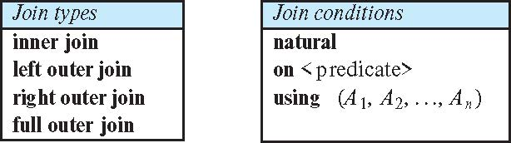
Joined Types and Conditions
Join operations take two relations and return as a result another relation.
These additional operations are typically used as subquery expressions in the from clause
Join condition – defines which tuples in the two relations match.
Join type – defines how tuples in each relation that do not match any tuple in the other relation (based on the join condition) are treated.

Slide 13
Join Condition
The on condition allows a general predicate over the relations being joined
This predicate is written like a where clause predicate except for the use of the keyword on
Query example
select *
from student join takes on student_ID = takes_ID
  The on condition above specifies that a tuple from student matches a tuple from takes if their ID values are equal.
Equivalent to:
select *
from student , takes
where student_ID = takes_ID

Slide 14
Join Condition (Cont.)
The on condition allows a general predicate over the relations being joined.
This predicate is written like a where clause predicate except for the use of the keyword on.
Query example
select *
from student join takes on student_ID = takes_ID
  The on condition above specifies that a tuple from student matches a tuple from takes if their ID values are equal.
Equivalent to:
select *
from student , takes
where student_ID = takes_ID

Slide 15
Outer Join
An extension of the join operation that avoids loss of information.
Computes the join and then adds tuples form one relation that does not match tuples in the other relation to the result of the join.
Uses null values.
Three forms of outer join:
  left outer join
  right outer join
  full outer join

Slide 16
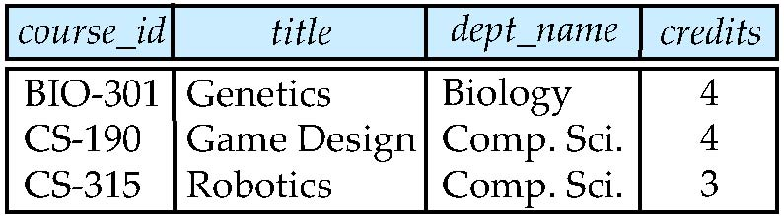
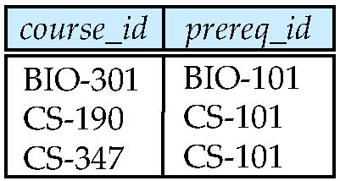
Outer Join Examples
Relation course
Relation prereq
Observe that
course information is missing CS-347
prereq information is missing CS-315
Notes:
-- 1.
CREATE TABLE course (
course_id VARCHAR(8) PRIMARY KEY,
title VARCHAR(100) NOT NULL,
dept_name VARCHAR(30) NOT NULL,
credits INTEGER CHECK (credits > 0)
);
INSERT INTO course (course_id, title, dept_name, credits) VALUES
('BIO-301', 'Genetics', 'Biology', 4),
('CS-190', 'Game Design','Comp. Sci.', 4),
('CS-315', 'Robotics', 'Comp. Sci.', 3);
-- 2.
CREATE TABLE prereq (
course_id VARCHAR(8),
prereq_id VARCHAR(8),
PRIMARY KEY (course_id, prereq_id)
);
INSERT INTO prereq (course_id, prereq_id) VALUES
('BIO-301', 'BIO-101'),
('CS-190', 'CS-101'),
('CS-347', 'CS-101');
select * from course natural left outer join prereq;
select * from course natural right outer join prereq;
select * from course natural full outer join prereq;

Slide 17
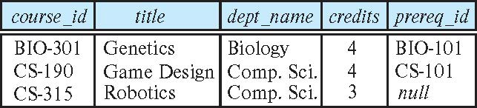
Left Outer Join
course natural left outer join prereq

Slide 18
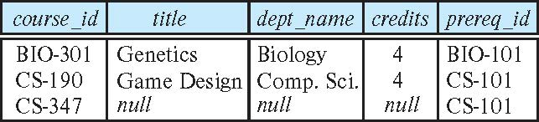
Right Outer Join
course natural right outer join prereq

Slide 19
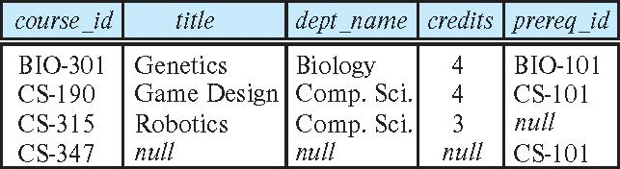
Full Outer Join
course natural full outer join prereq

Slide 20
*The impact of different writing methods on Join efficiency (chpt. 16)
The following minimalist but real-world example demonstrates how different approaches can lead to explosive intermediate results and vastly different computational effort, yet the final answer remains the same.
  See ‘3_compare_join.txt’
In most cases, PostgreSQL will automatically optimize. However, if you write the JOIN conditions as complex expressions or use views/CTEs, the optimizer may not be able to see the filter conditions, resulting in performance degradation.

Slide 21
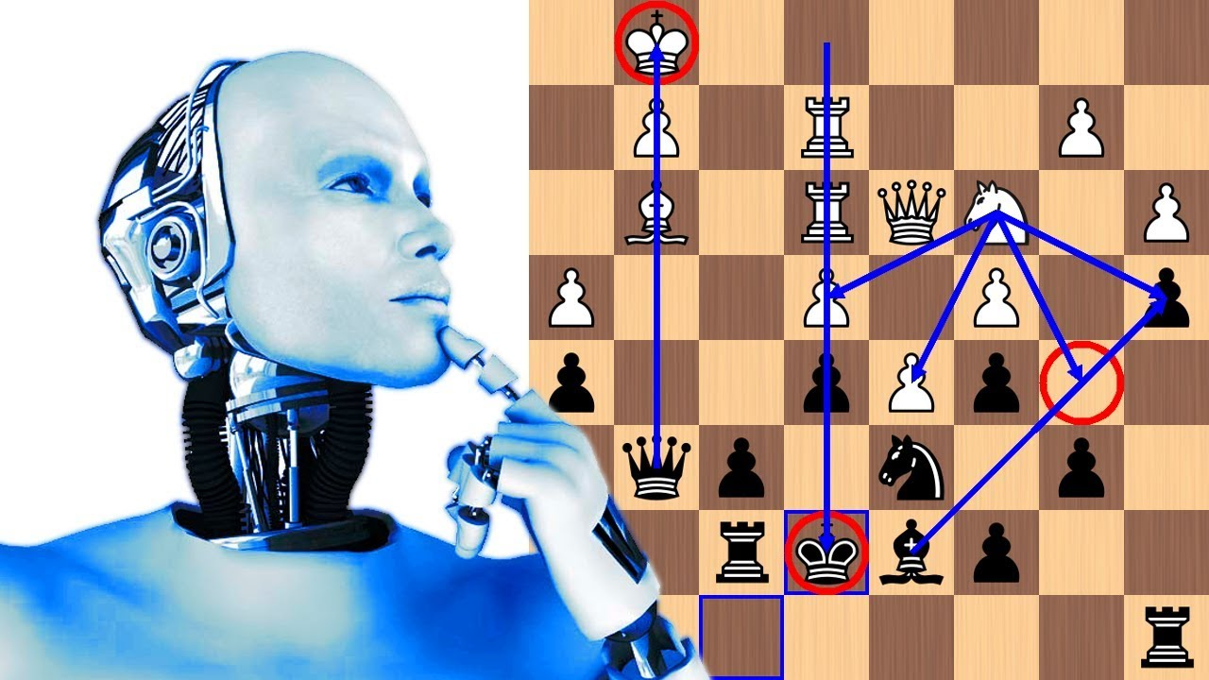
*Optimal path to execute ‘Join’
Similar approach to playing chesses with AI
  Define legal moves
  Define an evaluation function
  Search for the best solution（can be solved by various methods, such as Paper）

Slide 22
Views
In some cases, it is not desirable for all users to see the entire logical model (that is, all the actual relations stored in the database.)
Consider a person who needs to know an instructors name and department, but not the salary. This person should see a relation described, in SQL, by
select ID, name, dept_name
from instructor
A view provides a mechanism to hide certain data from the view of certain users.
Any relation that is not of the conceptual model but is made visible to a user as a “virtual relation” is called a view.

Slide 23
View Definition
A view is defined using the create view statement which has the form
create view v as < query expression >
where <query expression> is any legal SQL expression. The view name is represented by v.
Once a view is defined, the view name can be used to refer to the virtual relation that the view generates.
View definition is not the same as creating a new relation by evaluating the query expression
  Rather, a view definition causes the saving of an expression; the expression is substituted into queries using the view.

Slide 24
View Definition and Use
A view of instructors without their salary
create view faculty as
select ID, name, dept_name
from instructor
Find all instructors in the Biology department
select name
from faculty
where dept_name = 'Biology'
Create a view of department salary totals
create view departments_total_salary(dept_name, total_salary) as
select dept_name, sum (salary)
from instructor
group by dept_name;

Slide 25
Views Defined Using Other Views
One view may be used in the expression defining another view
A view relation v₁ is said to depend directly on a view relation v₂ if v₂ is used in the expression defining v₁
A view relation v₁ is said to depend on view relation v₂ if either v₁ depends directly to v₂ or there is a path of dependencies from v₁ to v₂
A view relation v is said to be recursive if it depends on itself.

Slide 26
Views Defined Using Other Views
create view physics_fall_2017 as
select course.course_id, sec_id, building, room_number
from course, section
where course.course_id = section.course_id
and course.dept_name = 'Physics'
and section.semester = 'Fall'
and section.year = '2017’;
create view physics_fall_2017_watson as
select course_id, room_number
from physics_fall_2017
where building= 'Watson';

Slide 27
View Expansion
Expand the view :
create view physics_fall_2017_watson as
select course_id, room_number
from physics_fall_2017
where building= 'Watson'
To:
create view physics_fall_2017_watson as
select course_id, room_number
from (select course.course_id, building, room_number
from course, section
where course.course_id = section.course_id
and course.dept_name = 'Physics'
and section.semester = 'Fall'
and section.year = '2017')
where building= 'Watson';

Slide 28
View Expansion (Cont.)
A way to define the meaning of views defined in terms of other views.
Let view v₁ be defined by an expression e₁ that may itself contain uses of view relations.
View expansion of an expression repeats the following replacement step:
repeat
Find any view relation v_{i} in e₁
Replace the view relation v_{i} by the expression defining v_{i}
until no more view relations are present in e₁
As long as the view definitions are not recursive, this loop will terminate

Slide 29
Materialized Views
Certain database systems allow view relations to be physically stored.
  Physical copy created when the view is defined.
  Such views are called Materialized view:
If relations used in the query are updated, the materialized view result becomes out of date
  Need to maintain the view, by updating the view whenever the underlying relations are updated.

Slide 30
Update of a View
Add a new tuple to faculty view which we defined earlier
insert into faculty
values ('30765', 'Green', 'Music');
This insertion must be represented by the insertion into the instructor relation
  Must have a value for salary.
Two approaches
  Reject the insert
  Insert the tuple
('30765', 'Green', 'Music', null)
into the instructor relation

Slide 31
Some Updates Cannot be Translated Uniquely
create view instructor_info as
select ID, name, building
from instructor, department
where instructor.dept_name = department.dept_name;
insert into instructor_info
values ('69987', 'White', 'Taylor');
Issues
  Which department, if multiple departments in Taylor?
  What if no department is in Taylor?

Slide 32
And Some Not at All
create view history_instructors as
select *
from instructor
where dept_name= 'History';
What happens if we insert
('25566', 'Brown', 'Biology', 100000)
into history_instructors?

Slide 33
View Updates in SQL
Most SQL implementations allow updates only on simple views
  The from clause has only one database relation.
  The select clause contains only attribute names of the relation, and does not have any expressions, aggregates, or distinct specification.
  Any attribute not listed in the select clause can be set to null
  The query does not have a group by or having clause.

Slide 34
Built-in Data Types in SQL
date: Dates, containing a (4 digit) year, month and date
  Example: date '2005-7-27'
time: Time of day, in hours, minutes and seconds.
  Example: time '09:00:30' time '09:00:30.75'
timestamp: date plus time of day
  Example: timestamp '2005-7-27 09:00:30.75'
interval: period of time
  Example: interval '1' day
  Subtracting a date/time/timestamp value from another gives an interval value
  Interval values can be added to date/time/timestamp values

Slide 35
Large-Object Types
Large objects (photos, videos, CAD files, etc.) are stored as a large object:
  blob: binary large object -- object is a large collection of uninterpreted binary data (whose interpretation is left to an application outside of the database system)
  clob: character large object -- object is a large collection of character data
When a query returns a large object, a pointer is returned rather than the large object itself.

Slide 36
User-Defined Types
create type construct in SQL creates user-defined type
  create type Dollars as numeric (12,2) final
Example:
create table department
(dept_name varchar (20),
building varchar (15),
budget Dollars);

Slide 37
Domains
create domain construct in SQL-92 creates user-defined domain types
  create domain person_name char(20) not null
Types and domains are similar. Domains can have constraints, such as not null, specified on them.
Example:
create domain degree_level varchar(10)
constraint degree_level_test
check (value in ('Bachelors', 'Masters', 'Doctorate'));

Slide 38
*Data Cleaning
Extract, transform, load – Wikipedia
Benefits
  1. The original table remains unchanged, allowing for rollback at any time.
  2. The cleaning logic is entirely contained within the VIEW, allowing version control with a SQL file.
  3. If you want to add new rules, simply wrap it in another VIEW; the old VIEW remains available for historical tasks.
  4. If you want to materialize the data later, simply create a materialized view mv_clean AS select * from v2_orders_valid; to speed things up.
  This is the typical "using VIEWs for data cleaning" in PostgreSQL: dirty data remains in place, while clean data is "projected" as needed.

Slide 39
*Comparison of Tools
 | Easy to use | Performance | Memory | Scalability
Linux Command Line | Not good | Good | Based on disks | No
Python/Pandas | Not bad | Slow | Based on main mem | No
SQL/DB | Good | Slower than Linux, faster than Pandas | Based on disks | Hadoop can do it best
GUI Tools | Great for small tasks | Depends on the underlying implementation | Depends on the underlying implementation | Depends on the underlying implementation

Slide 40

**Mathematical thinking in DB (chpt. 2.6)
What is ‘legal moves’?
  Where a and where b ⬄ Where b and where a : commutative law
  Nature Join satisfy association law
  Exchange join and where: distributive law
  …
It is similar to what we have learned in math…

Slide 41
**Modeling with a kind of… Algebra??
Informally speaking, algebra usually refers to something supporting ‘add’ and ‘multiply’, as well as their inversion (‘subtract’ and ‘divide’)
How many algebras do you know?
 | + | ×
Elementary algebra (for children) | add | multiply
Polynomial Algebra | add | multiply

Slide 42
**Relational Algebra
 | + | ×
Boolean algebra (in computer science) | or | and
Linear algebra | add | product
Sigma algebra (in probilitstic theory) | union | interset
Relational Algebra | Union | Join
Example (Not strictly speaking)
  Two tables with the same schema can be united
  Two tables with common keys can be Joined
Notes:
https://en.wikipedia.org/wiki/Algebra

Slide 43
***Application
Find all equivalent queries
  Traverse the equivalent form of an expression according to the transformation rules. Then a selection of the best form can be conducted.
Query = Solve Boolean equations
  Combined with other types of equations (such as linear equations), more complex queries can be implemented, such as: Q: Under what conditions can Alice receive a scholarship? A: improve GPA at least 0.3.
Automatic normal form conversion
  Polynomial factorization minimizes redundancy under a multiplication structure; database normal form decomposition minimizes redundancy under a connection structure. The normal form can be converted automatically.

